Slide 1
Gesture Recognition System for converting sign language to text and audio using Video Analysis.
Presented By- Guided By-
Aishwarya Gurjar Dr. Urjita Thakar
Divas Jain
Mansi Agrawal
Romil Jain
Siddhant Gupta

Slide 2
Introduction
WHY Gesture?
Gesture Recognition

Slide 3

What is Gesture?
Gesture is a form of natural expression.
Non-verbal communication or non-vocal communication in which visible bodily actions communicate particular messages.
A movement of part of the body, especially a hand or the head, to express an idea or meaning.
Gesture is a form of human language.

Slide 4
Why ?
Gestures are naturally used by many peoples and are especially major and natural way of interaction for deaf/blind people.
Gesture recognition is to recognise specific human gestures and process them .
Building gesture recognition system means building computer keen to understand human language, thus building a human computer interaction.

Slide 5
Gesture Recognition
Gesture recognition is to recognize specific human gestures and process them to control device.
The human gestures are transmitted via special glove or read by a camera.
The captured data is processed and used as an input to handle applications or devices.
On the basis of data acquisition, the gesture recognition is categorized into Glove based and Vision based gesture recognition system.

Slide 6
Applications of Gesture Recognition
Entertainment applications – Most video games today are played either on game consoles, arcade units or PCs, and all require a combination of input devices.
Sign Language recognition - A system that can recognize human gestures could provide a new way for people with physical disabilities to interact with computers.

Slide 7
Continued..
Automation systems – In homes, offices, transport vehicles and more, gesture recognition can be increase usability and reduce the resources like remote controls, car entertainment systems with buttons or similar.
Medical Applications – Advanced robotics systems with gesture recognition can be placed in hospitals or homes to recognize and treat life threatening conditions like heart attacks or strokes.

Slide 8
Problem Statement
Hand gesture recognition system received great attention in the recent few years because of its various applications.
The essential aim of building hand gesture recognition system is to create a natural interaction between human and computer. The recognized gestures will be converted into readable form and audio for interaction with specially abled people.
The system will use normal RGB camera rather than expensive 3D cameras and sensors which are being used.

Slide 9
Project Scope
Project Goal:
To build a real time gesture classification system that can detect sign symbols using a real time gesture based system developed to identify gestures.
Build a system simple, easy and user friendly without using any special hardwares.
All computations will occur on single PC or workstation.
Deliverables:
Software program that recognise gesture and convert it into text and audio.

Slide 10
Continued..
Objective:
Create a complete system to detect, recognize and interpret the hand gestures through computer visions.
Boundaries:
Single person in frame at a time.
Distance of person making gestures should be almost same as in the training set of that gesture.
Cost:
Training Cost
Camera Cost

Slide 11
Background Study
Not a novel Problem.
Many companies tried and built gesture recognition system.
BUT not widely accepted.
WHY?
Gesture Recognition
Notes:
vhjreb\viuvewic

Slide 12
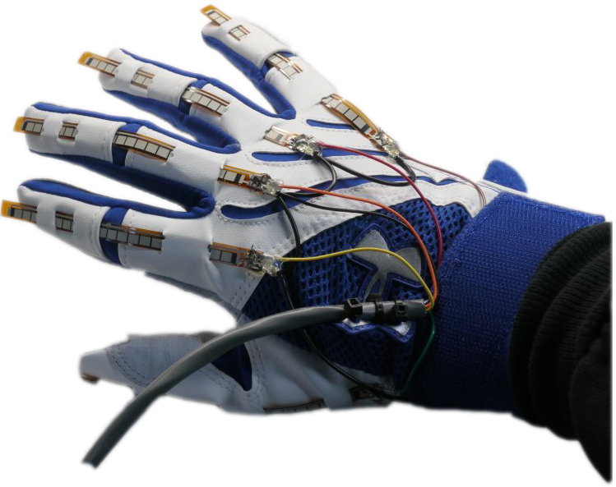
Current Scenario
Any of the famous Gesture recognition system!?
Wired Gloves
These can provide input to the computer about the position and rotation of the hands using magnetic or inertial tracking devices.
The first commercially available hand-tracking glove-type device was the DataGlove.

Slide 13
Microsoft Kinect
Kinect is a line of motion sensing input devices that was produced by Microsoft for Xbox 360 and Xbox One video game consoles and Microsoft Windows PCs.
Has a depth camera.
One can generate a depth map of what is being seen through the camera at a short range, and use this data to approximate a 3d representation of what is being seen.
One or more Kinects can be used for the whole 3d projections.
The video and depth sensor cameras have a 640 x 480-pixel resolution and run at 30 FPS (frames per second).

Slide 14
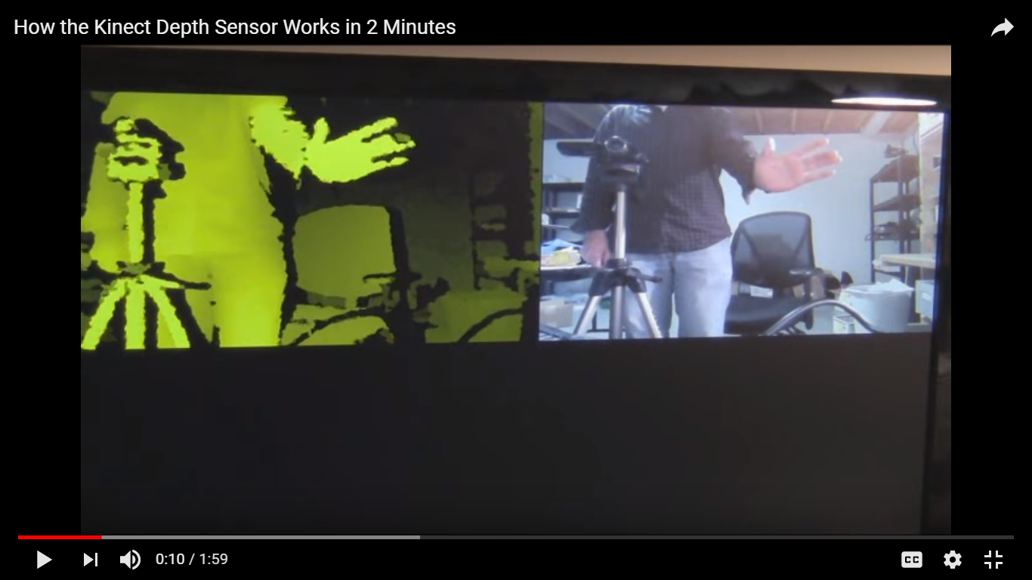
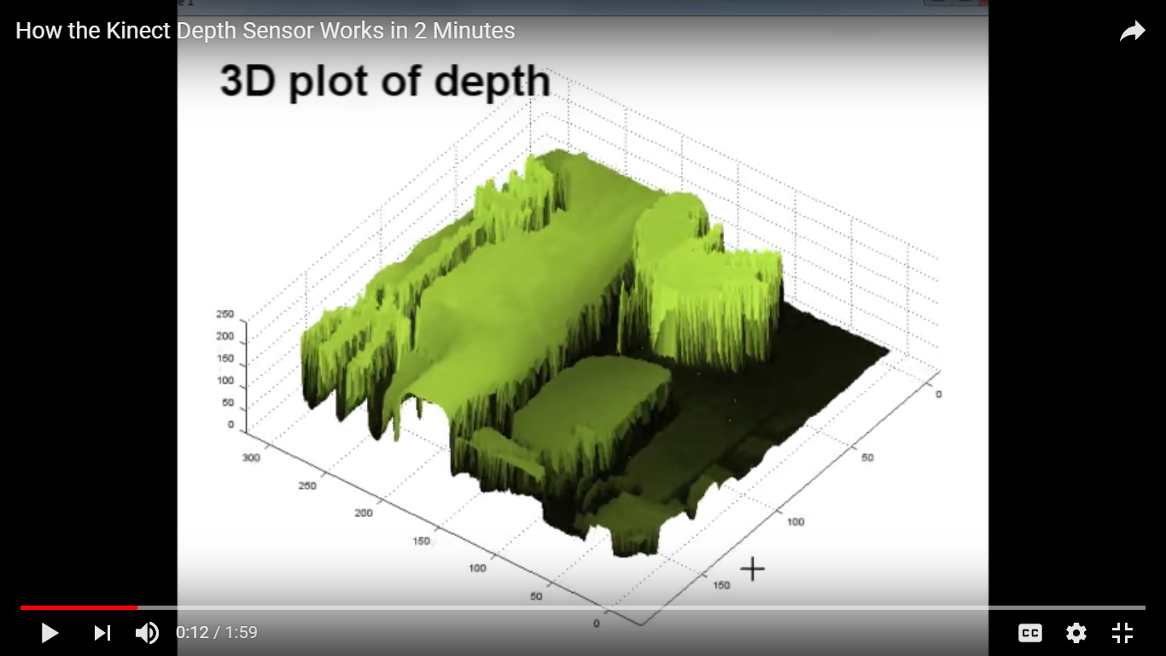
Depth Camera Visualization

Slide 15
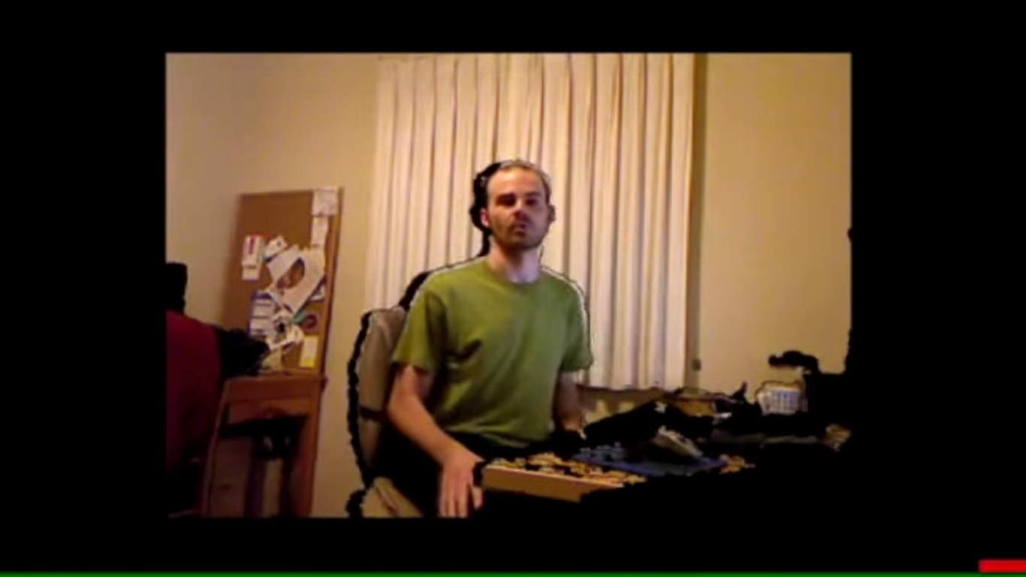
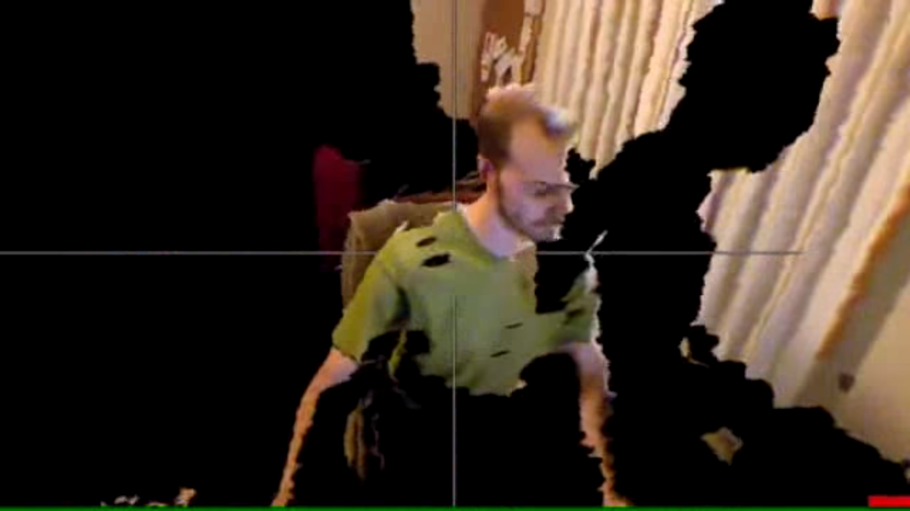
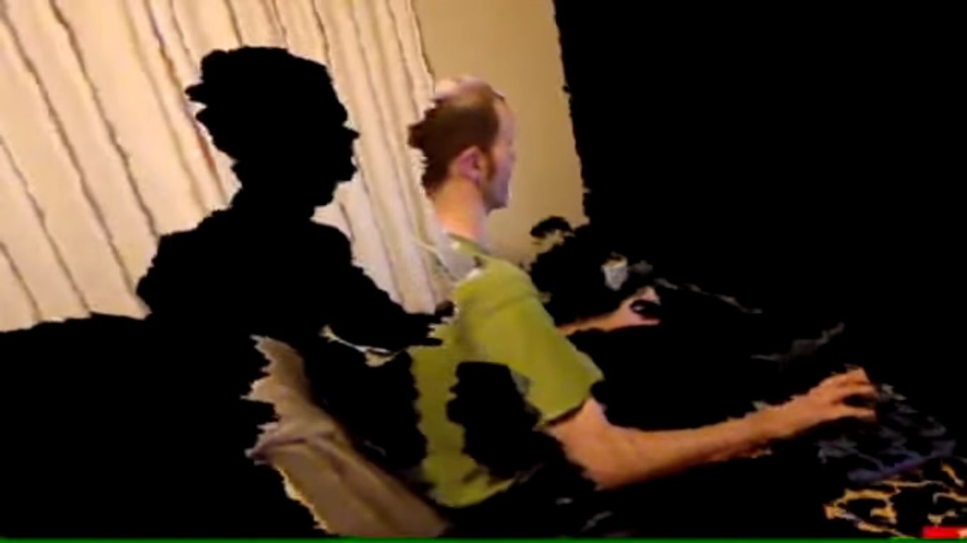
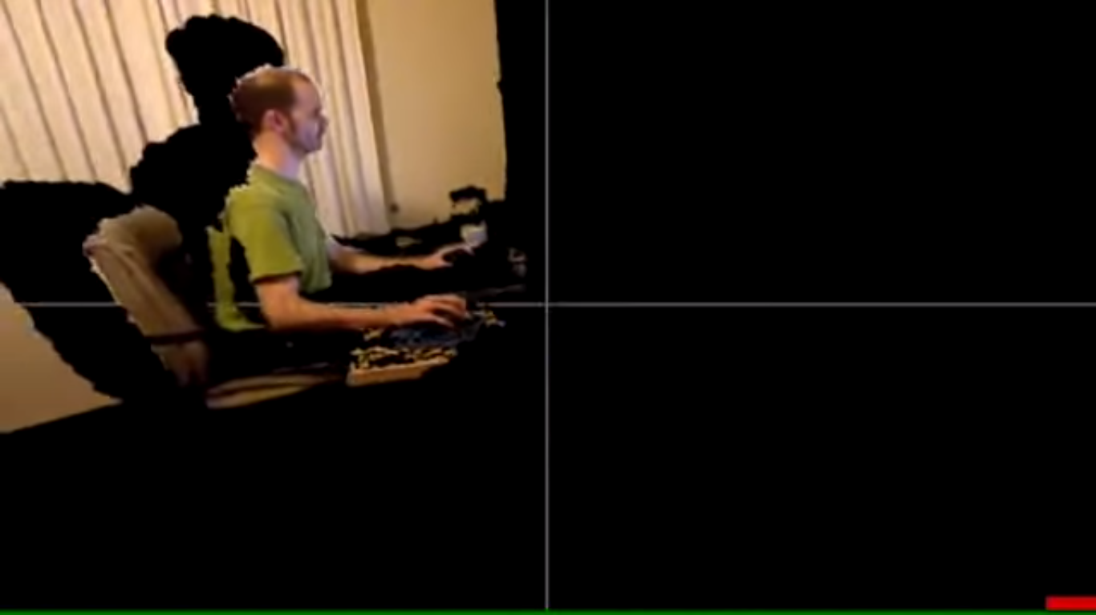

Slide 16
Continued..
Stereo Camera
Using two cameras whose relations to one another are known, a 3d representation can be approximated by the output of the cameras.
This is very similar to how the human brain uses stereoscopic information from the eyes to gain depth cue information, i.e. how far apart any given object in the scene is from the viewer.
Gesture-based controllers
These controllers act as an extension of the body so that when gestures are performed, some of their motion can be conveniently captured by software.

Slide 17
An example of emerging gesture-based motion capture is through skeletal hand tracking. An example of this technology is shown by tracking companies uSens and Gestigon.

Slide 18
Existing Challenges
The existing gesture recognition systems are not widely accepted for “they always required some additional sensors for their functioning.”
This hardware required for the existing system are very costly, which makes them inaccessible to a major section of society.
There is no implementation of Deep Learning in any of the present recognition system.
Some of the existing systems are considering only the static image into consideration.
Neglection of temporal factors.

Slide 19
Proposed Enhancements
On the contrary, we decided to try it do without any sensors.
We decided to just feed a neural network with huge amount of data and to do it without any additional devices.
Without Additional devices, is paramount, because this means that the end user in the end would only merely need a webcam or a laptop camera to be able to use a gesture recognition system.

Slide 20
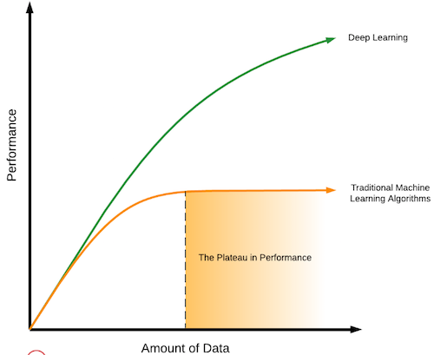
Why Deep Learning ?
While training large amount of data, Deep Learning Algorithm performs much better than traditional ML Algorithm.
Deep Learning really shines when it comes to complex problems such as image classification, natural language processing and speech recognition.

Slide 21
Requirement Analysis
How do we get such a huge amount of data ?
Data Scraping
It involves crawling the www using Hypertext Transfer Protocol or through a web browser.
Scraping the videos for each gesture from the internet.
Notes:
Now to feed the deep learning model we require a huge amount of data.
So the question arises how to we get the data?
One possible answer could be the data scraping

Slide 22
Problems with this approach :
Time consuming
You might not get right amount of data
Data might be not balanced
Multiple people performing multiple gestures in a single frame simultaneously
People may perform gestures with different perspectives
Long streaming with only few second of gesture
Notes:
This approach sounds good but practically it is not suitable for our system
But it has some problem associated with it which are….

Slide 23
Collecting the data within our team
Recording the videos
Annotating the videos
Problems:
Not possible in practice if we are talking about thousands of videos

Slide 24

Dataset sample

Slide 25
Bottlenecks
Starving GPU Problem
Image datasets or image recognition cases
The image data set is usually small enough to fit in file system cache. During training the initial epoque would be little bit slower because of the data reading from the disk but the next iterations won’t be your bottleneck.

Slide 26
Video datasets or Video Recognition
Video data is itself large comparative to image data and when you have thousands of videos, they do not fit into file system cache. So in each iteration you have to read data over and over again and this would become our bottleneck.

Slide 27
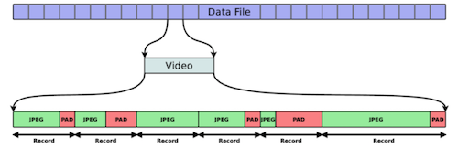
Solution
We have referred to a data format in which-
All the frames of a video are concatenated as a JPEG images into a single data-file and save the offsets and metadata in a secondary meta-file.
Using JPEG compression that reduces the file size significantly
An important feature of the format is that multiple videos can be stored in a single chunk.
Since all videos and all frames stored sequentially, it circumvents many delays caused by seeking from magnetic storage.

Slide 28
What we are going to recognize?
10 Numbers (0,1,2,3,4,5,6,7,8,9)
22 Universal gestures for e.g. Time, call, drink, eat etc
26 Alphabets (A,B,C…...Y,Z)
63 Basic function for e.g Hello, me, you, they etc

Slide 29
Model
Our Model is inspired by the paper by Nvidia Gesture Recognition System which was published on 2016.
There are slight differences in their dataset which consists of 1500 videos and they also used depth information using Microsoft kinect.

Slide 30
Nvidia system architecture

Slide 31
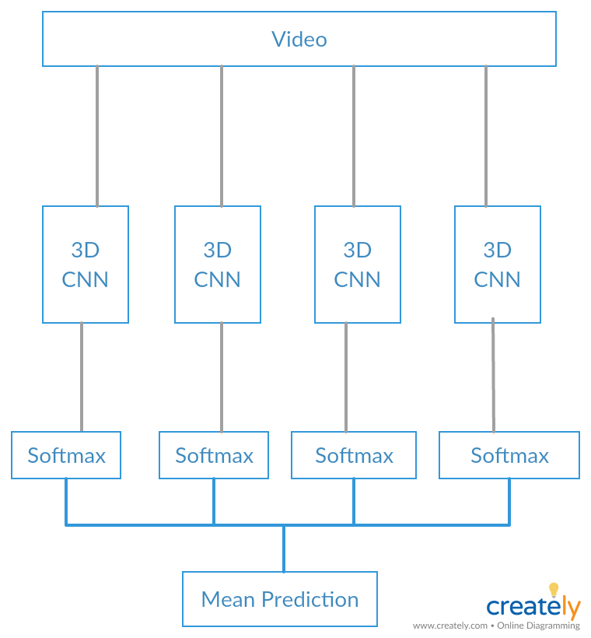
Nvidia’s Approach
Tasks:
Breaking the clips into frames.
Changing the resolution of frames to the desired resolution.

Slide 32
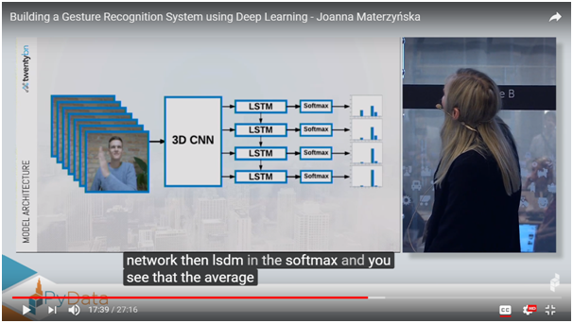
Input Data
Video - Stack of frames
Image/frame converted to lower resolution
Input
Trained Model
Output
Text/Audio

Slide 33

Example

Slide 34

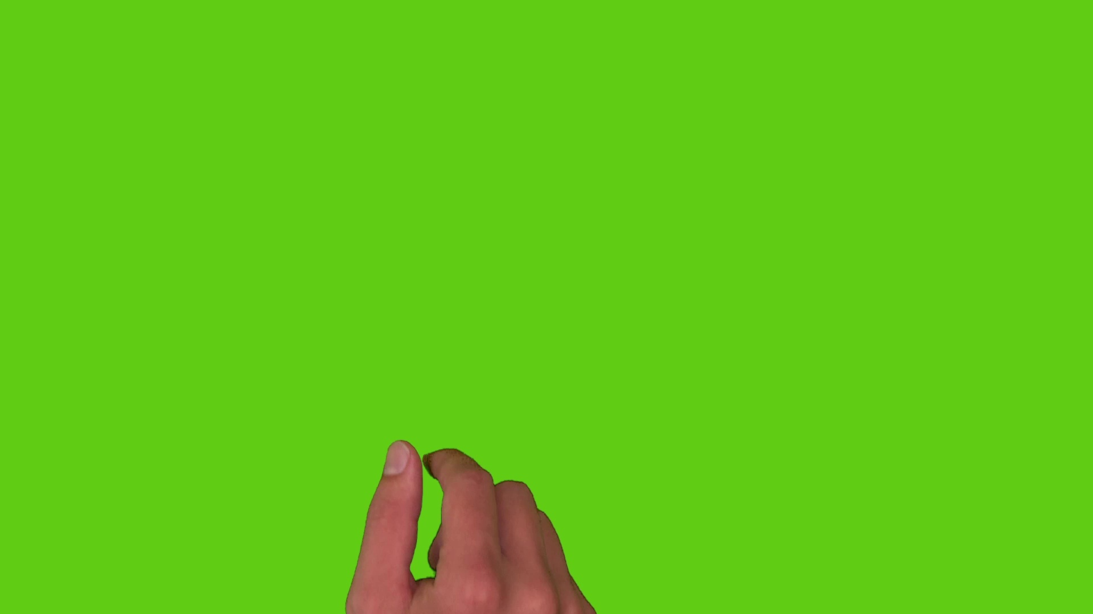
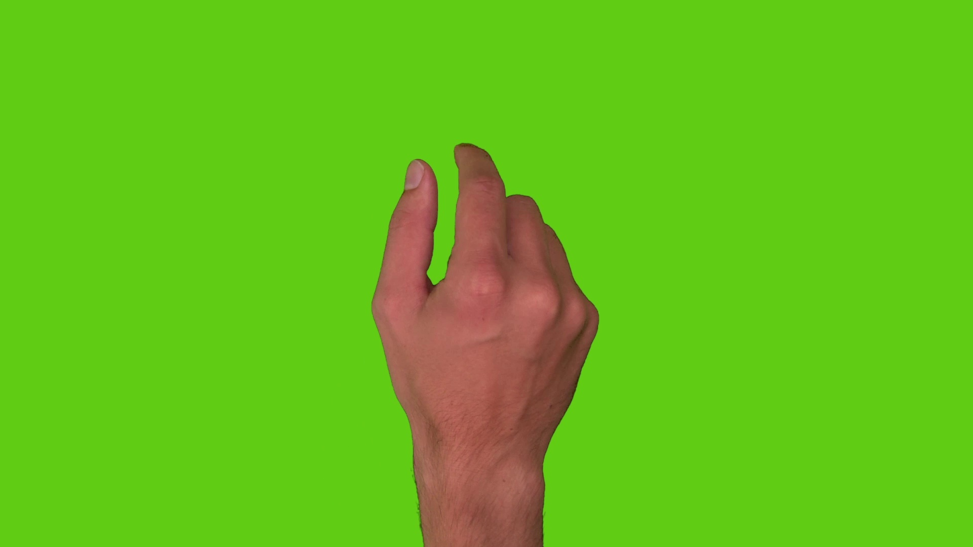
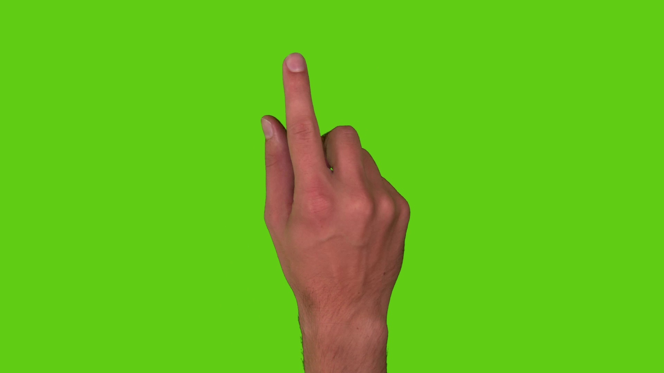
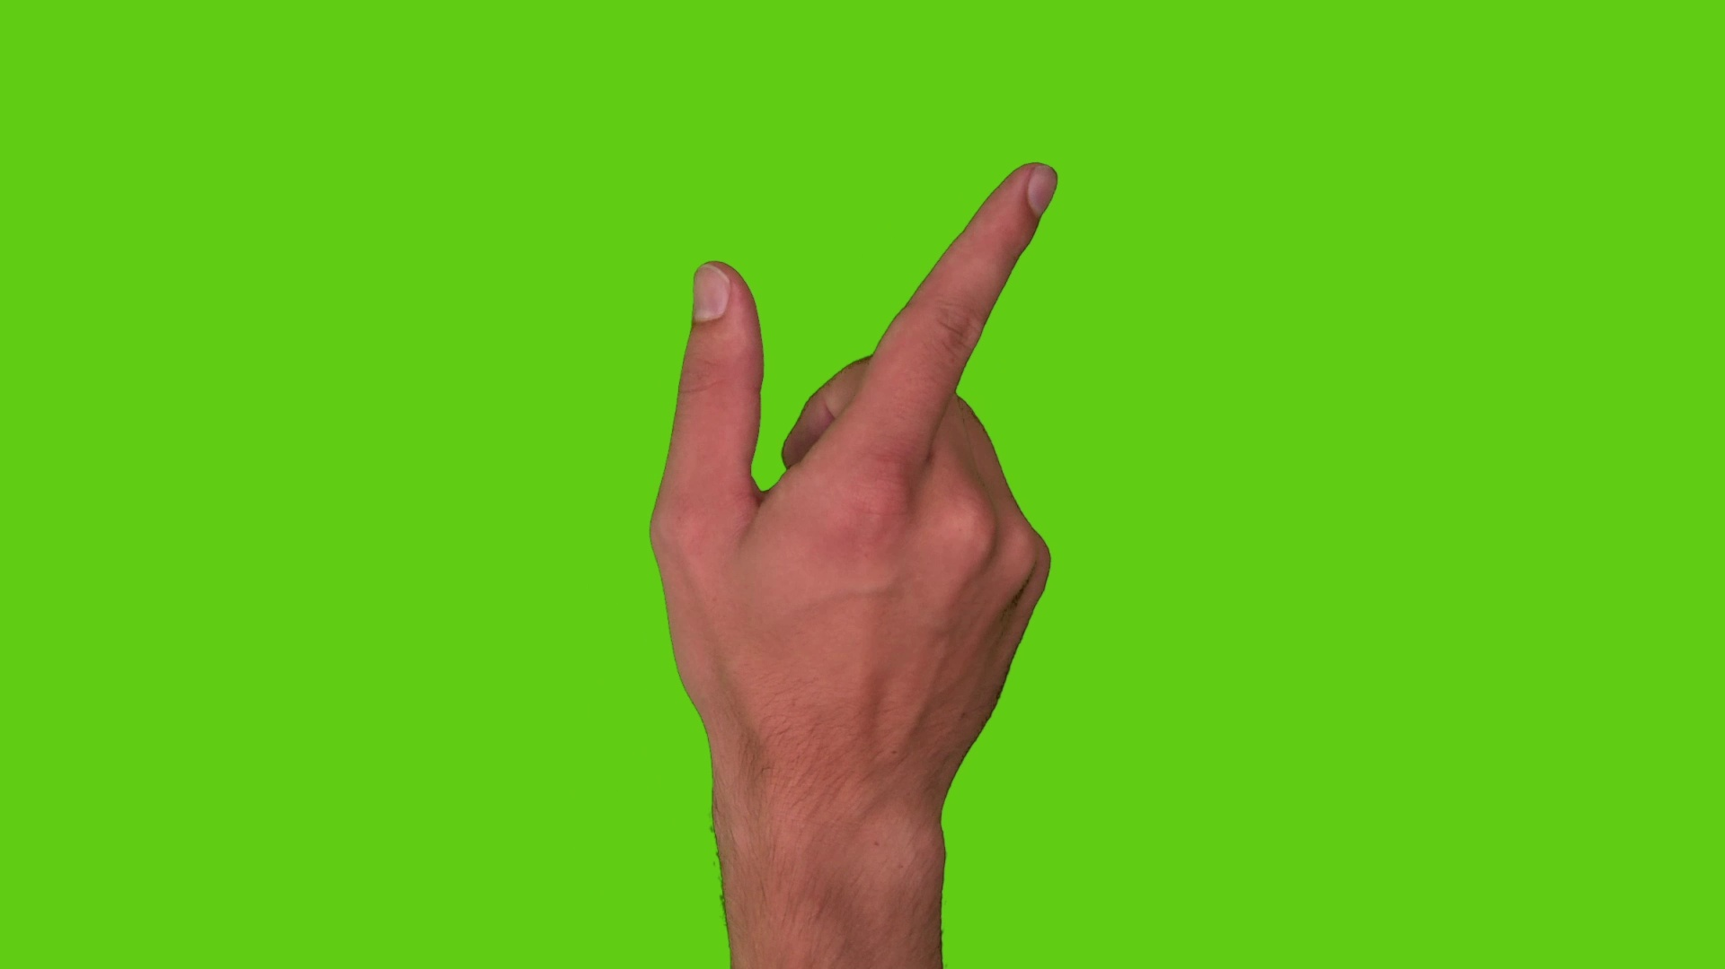
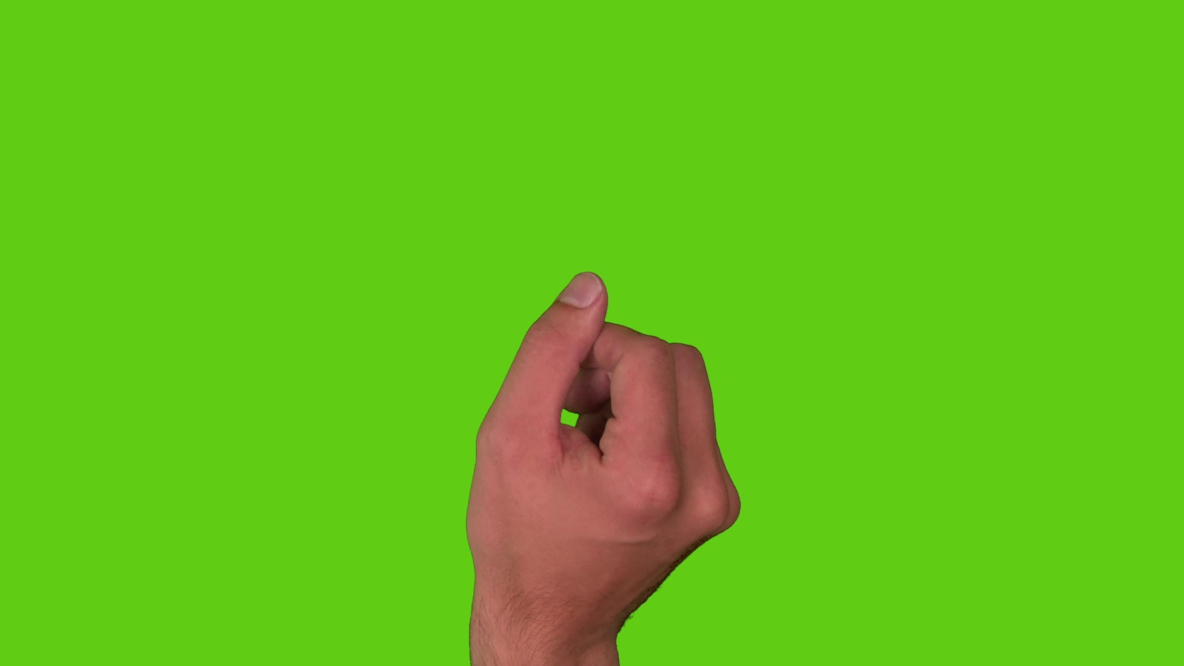
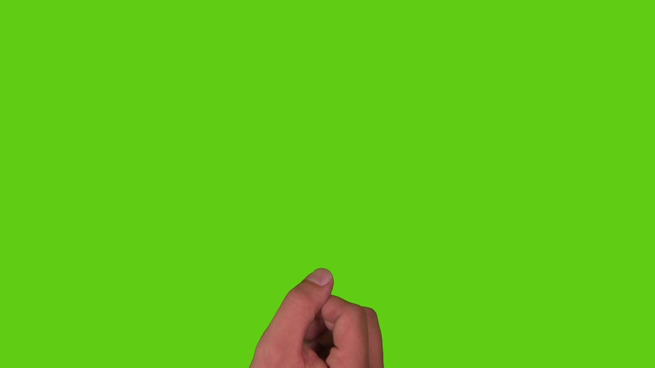
Conversion of Video into Frames

Slide 35

Changing the resolution of frames to the desired resolution.
High resolution
Lower resolution

Slide 36
Convolutional Neural Network
CNN is a class of deep, feed-forward artificial neural networks, most commonly applied to analyzing visual imagery.
Fundamental block - Convolution operation
Motivation - Edge detection(Vertical,Horizontal,Inclined at some angle)
Why CNN?
Able to learn more relevant features(very good feature extractors)
Supports weight sharing hence less number of parameters to be learned(less prone to overfitting)
Reduces time and space complexity

Slide 37
Layer based architecture
It constitutes of three layers:
Convolution
-apply filters
Pooling
-reduce the size of representation(hence speed gain)
Fully connected
-connect every activation unit of a layer to every other activation unit in next layer

Slide 38
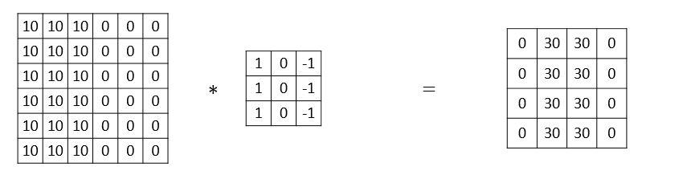



Convolution (Edge Detection)

Slide 39
Why convolutions
Parameter sharing: A feature detector (such as a vertical edge detector) that’s useful in one part of the image is probably useful in another part of the image.
Sparsity of connections: In each layer, each output value depends only on a small number of inputs.

Slide 40
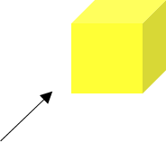
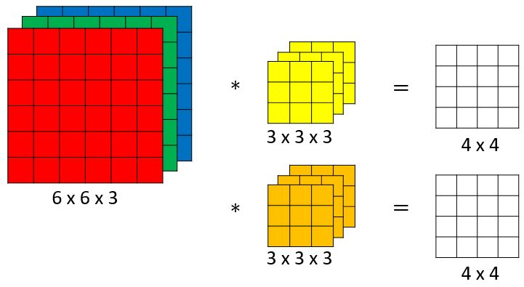
Convolutions on RGB images
Different channel for each R,G abd B pixel values of an image
Can get hundreds of features or even hundreds of thousands of features by using several filters

Slide 41
Pooling and Fully Connected layer
Both implemented as alternate layers in the model.
Pooling layer:
Important features get preserved
Reduce the size of the image(shrink the height and width)
Fully connected layer:
Connects every activation unit of the unrolled pooling layer to the next layer
Max Pool
Conv layer
Pool layer

Slide 42
Why 3D CNN?
2D CNN only captures spatial features across each depth(for RGB images).
3D CNN captures the time sequence of the frames in the video that represents a particular gesture.
In other words, the temporal aspect of the data is incorporated as the third dimension in the 3D CNN

Slide 43
Limitations of Nvidia’s Approach
No time sequencing
Overhead of dividing video into chunks to be fed in CNN
Softmax is classifying the chunks individually which are then being averaged to get the final gesture.

Slide 44
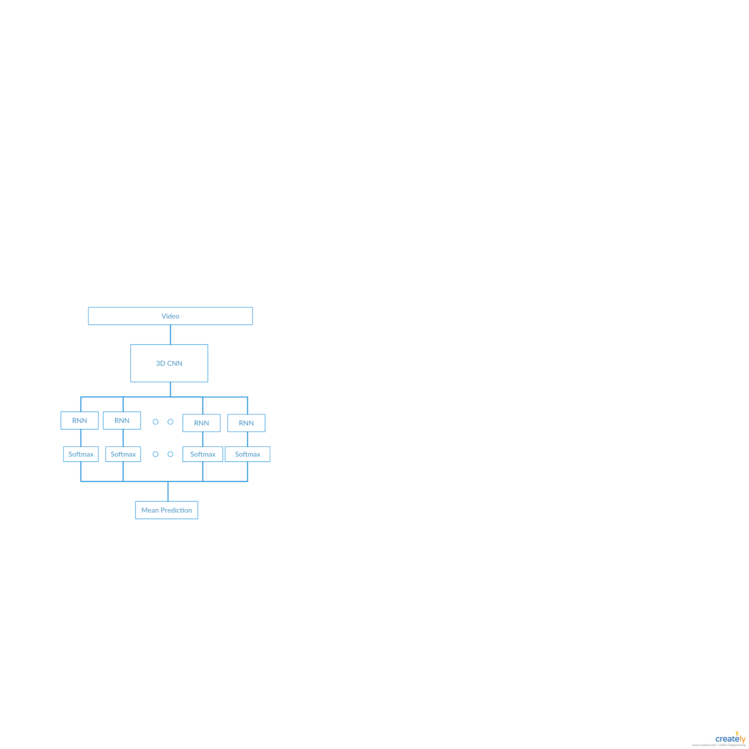
Proposed Approach

Slide 45
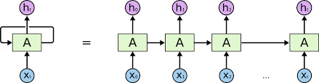
Recurrent Neural Network
A recurrent neural network (RNN) is a class of artificial neural network where connections between nodes form a directed graph along a sequence. This allows it to exhibit temporal dynamic behavior for a time sequence.
Sequencing Model

Slide 46
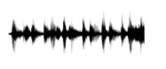
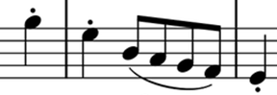
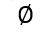

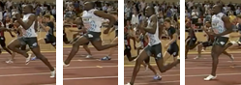
Examples of sequence data
“The quick brown fox jumped over the lazy dog.”
Speech recognition
Music generation
Sentiment classification
“There is nothing to like in this movie.”
Machine translation
Voulez-vous chanter avec moi?
Do you want to sing with me?
Video activity recognition
Running

Slide 47
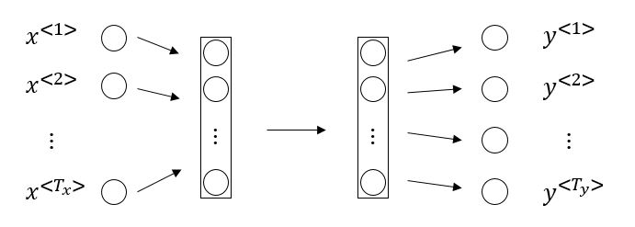
Why not a standard network?
Inputs, outputs can be different lengths in different examples.
Doesn’t share features learned across different positions of text.

Slide 48
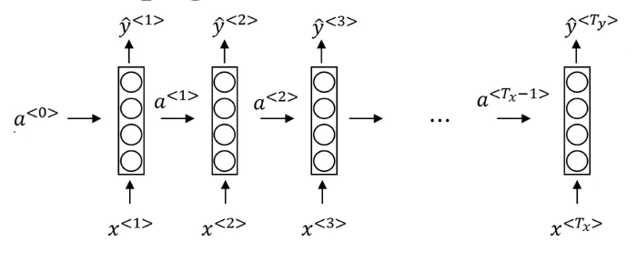
Why Recurrent Neural Network?
In RNN the first input of a test case helps in identifying the time sequence of the frames.
It remembers features from the input and the output of these features are given as input to the next layer in order to learn across different position of the data

Slide 49
Problems with Simple RNN Network
Vanishing Gradient Problem
Sometimes, we only need to look at recent information to perform the present task.
“The cat eat and was full”
It is pretty obvious that the next word will be .
“The cat ate the food and went for a walk in the garden because it (was/were) full.”
Recent information suggests that the next word is probably the name of a language, but which language?

Slide 50
Long-Short Term Memory
Long Short-Term Memory (LSTM) networks are a type of recurrent neural network capable of learning order dependence in sequence prediction problems.
A type of Recurrent Neural Network that used references from a context far back.

Slide 51
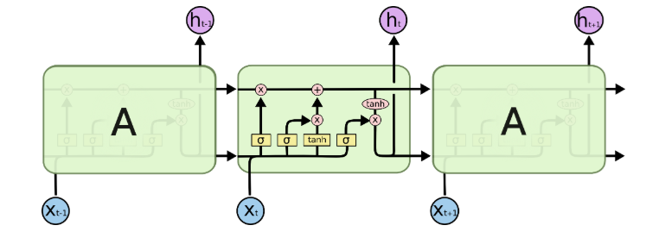
Long-Short Term Memory (Cont.)
LSTMs are explicitly designed to avoid the long-term dependency problem.
LSTM also has a chain like structure but the basic repeating unit is not the same as the normal RNN.

Slide 52
Tools and Technology
vPython 3.x
PyTorch: 0.4.0 (conda installation preferred - ref https://pytorch.org/)
Python Library
Torchvision
Matplotlib
skvideo (scikit-video)
PIL
Opencv-python
Dataset(http://csr.bu.edu/asl/asllvd/annotate/session_1-2/index_session_1-2.html)
GPU (Graphic processing Unit) Nvidia 940m 2 GB dedicated.
RGB Camera.

Slide 53
Feasibility Study
Technical Feasibility
Computational Feasibility:
Time required to framing a video=4.633311748504639 seconds
Total hours to process video 77 hours.
But this is a one time investment.
2 Convolutional ,2 Pooling ,2 full connected.(min)
LSTM recurrent Neural Network with n different branches
The data format we have used speeds up the hdd access upto 9 to 16 times.
The total amount of data we have 100*121*12*100*100*3=4356000000 pixels
The training of one epoque takes around 1 Hour on Nvidia GTX 1080

Slide 54
Result Feasibility
As this type of system has been developed by Nvidia on 1500 videos according to the research paper published on 2016.
This project is an extension of the research paper and will have a greater accuracy rate the there system that is 75%.

Slide 55
Hyperparameter And Other parameters
Hyperparameters
No of layers.
No of hidden layers.
Learning rate.
Activation Function.
No of iteration
Other parameters
How to divide the data into train/test/dev set.
Bias/Variance.
Regularisation
Normalization

Slide 56
References
http://colah.github.io/posts/2015-08-Understanding-LSTMs/
https://becominghuman.ai/a-noobs-guide-to-implementing-rnn-lstm-using-tensorflow-1907a5bbb1fa
https://towardsdatascience.com/why-deep-learning-is-needed-over-traditional-machine-learning-1b6a99177063
http://csr.bu.edu/asl/asllvd/annotate/session_1-2/index_session_1-2.html

Slide 57
Thank You!

